Slide 1

Project Title: Heart Disease Prediction Using Machine Learning
Port City International University
Submitted To Submitted by
Name: Abdur Rahman Name: Ummeh Asma Beauty
Lecturer, Program: B.Sc in CSE
Department of CSE Id No: CSE 01506429
Port City International University Batch: CSE 15 (A)

Slide 2
Contents
confussion matrix
confussion matrix
Introduction
Objective
Methodology
Required Tools
Confussion Matrix
Classification Report
Test Data
Conclusion

Slide 3
Introduction
Heart Disease is any condition that reduces the strength of functioning of the heart and blood vessels. Heart disease is the leading cause of death in the United States. It is also the most preventable. Types of Heart Disease.
The most hard-working muscle of our body – pumps 4-5 liters of blood every minute during rest.
Supplies nutrients and oxygen rich blood to all body parts, including itself .
Coronary arteries surrounding the heart keep it nourished with blood

Slide 4
Objective
•To find the term heart disease.
•To find the common types of heart diseases.
•To identify risk factors of Heart disease.
•To find the signs and symptoms of heart disease .
• To find the common diagnostic measures used in heart disease.
•To find the common treatment interventions.
•To find the preventative measures .

Slide 5
Methodology
Train Test Split
DATA
train
test
Algorithm
Evaluation

Slide 6
Required Tools
Spyder Python(3.8)
Anaconda Navigator

Slide 7


Confussion Matrix:

Slide 8

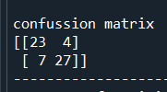

Slide 9
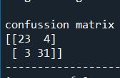


Slide 10
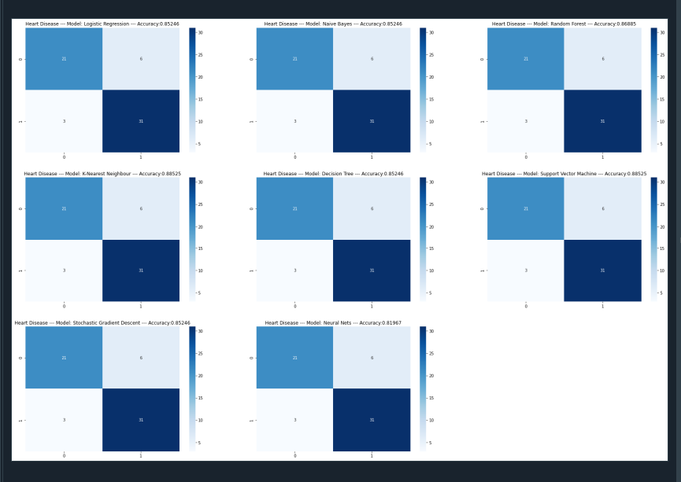
Confussion Matrix Comparison Chart:

Slide 11
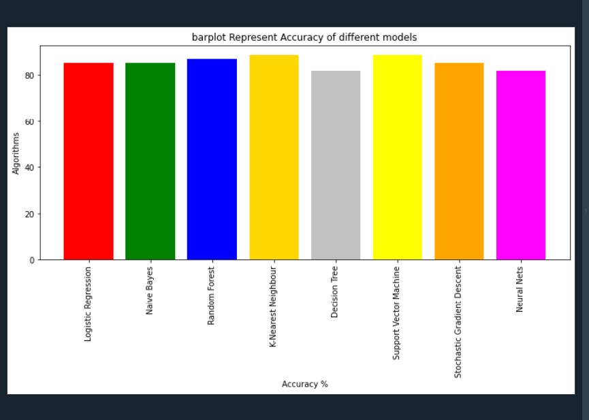
Accuracy:

Slide 12
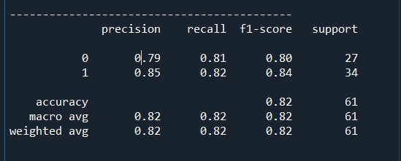
Classification
Classification is the task of assigning a class label to an input pattern. The class label indicates one of a given set of classes.

Slide 13
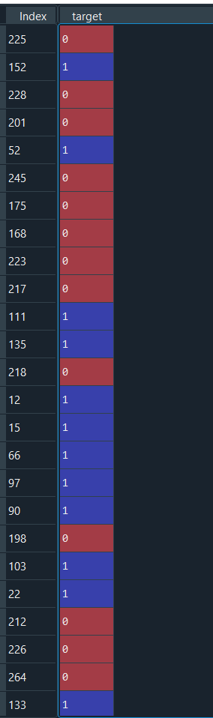
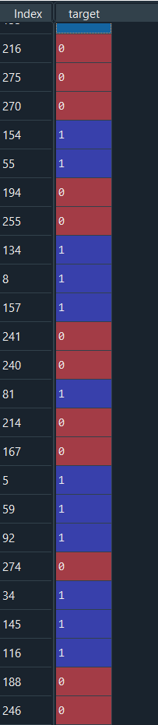

Test Data

Slide 14
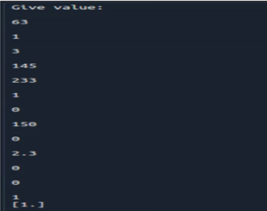
Test Data (User Input)

Slide 15
Conclusion
1. Out of the 13 features we examined, the top 4 significant features that helped us classify between a positive & negative Diagnosis were chest pain type (cp), maximum heart rate achieved (thalach), number of major vessels (ca), and ST depression induced by exercise relative to rest (oldpeak).
2. Our machine learning algorithm can now classify patients with Heart Disease. Now we can properly diagnose patients, & get them the help they needs to recover. By diagnosing detecting these features early, we may prevent worse symptoms from arising later.
3. Any accuracy above 70% is considered good, but be careful because if your accuracy is extremely high, it may be too good to be true (an example of Over fitting). Thus, 80% is the ideal accuracy!

Slide 16
Thank You

